Slide 1
RAILWAY RESERVATION SYSTEM ABSTRACT
The purpose of Online Railway Reservation System is a software application which provides the train details, route details, route fix, route cancellation, reservation, cancellation and ticket issuing. Using this system a person can perform operations like finding out the train information and to know about PNR status, seats availability and costs of each ticket etc.
The system is designed to handle all the activities of the passengers, staffs as well as the administrative level. The system will have the ability to search the route information about different trains, routes and reservation status and remaining seats of a particular train. The database will be updated automatically in a real time manner. This system is for railway so that primary users of the system are the passengers, staffs and the administrative panel.
The main users in this system are:
Admin
User

Slide 2
MODULE DESCRIPTION
The different modules are:
Administrator Module
Passenger Registration Module
Train Search Module
Ticket Reservation Module
Ticket Cancellation Module
Administrator Login
The whole system is controlled by an administrator, administrator login into system by giving his authentication details such as username and password. After login into the system, he can see the trains currently available to the passengers. The train details are Train name, departure, destination, seat availability, and running days. And administrator can also add a new train into the databases.

Slide 3
Passenger Registration
If any user doesn’t have username and password to login into the system, then he can choose to register as a new member by choosing register option. He prompt to give his personal and contact information such as name, address, phone number, email id, and he can choose his own username and password. If registration is success then the user can login into the system, by username and password chosen by him/her.
Train Search
Passenger can search the available trains by their requirements. The requirements may departure, destination, journey date. The list of available trains is shown to the user. Then user may select any train and make ticket reservation. If no train is available, then user may change the journey date, departure, or destination.
Ticket Reservation Module
If the journey date, destination and departure is match for a train then the passenger can select the particular train, after selecting the particular train, user will get the trains details and seat availability in each class, the classes will be AC, Sleeper and seater class

Slide 4
Ticket Cancellation Module
An E- ticket cannot be cancelled at any Reservation counter of the Railways. It can only be cancelled online. The passenger can cancel the E-Ticket before preparation of reservation chart of the train by logging in his User ID and password. Reservation Charts are normally prepared 4 hours before departure of the train from Train originating station. Cancellation is not possible through any other User ID and password. Upon cancellation of ticket, IRCTC will process the refund electronically and credit the amount in same account which was used at the time of booking of tickets.

Slide 5
About
Our topic is “Railway Reservation system”. The purpose of Online Railway Reservation System is a software application which provides the train details, route details, route fix, route cancellation, reservation, cancellation and ticket issuing. Using this system a person can perform operations like finding out the train information and to know about PNR status, seats availability and costs of each ticket etc.
We are doing our project in JSP. Building tools are :
Eclipse
Netbeans
GITHub

Slide 6
Eclipse : It is more of a shell-like architecture that is extended through plugins and there are thousands of plugins to choose a frame. It`s core foundation is written in Java. Netbeans : It is an IDE and it is the entire platform. It describe itself as an IDE that “let`s you quikly and easily develop java desktop, mobile and wb application, as well as HTML5 application.” Git : It is a version control system. Git was originally designed to help manage the Linux kernel and make collaboration easy from the beginning.

Slide 7
EXISTING SYSTEM
At present system you can get complete information regarding train schedule and seats availability just sitting at your place but the drawback is the procedures are very complicated for an ordinary man otherwise have good knowledge in computer operation. So, the status of the train reservation is unpredictable for the passengers and they don’t have enough knowledge about the running trains at different locations so, there arises a need to visit the enquiry corner so as to collect the detailed information about the desired train.

Slide 8
PROPOSED SYSTEM
The project, Railway Reservation System aim is to provide a secure and easy way to book train tickets. This project should be able to manage all the reservation related functions.
PURPOSE:
The purpose of Railway Reservation System is a software application which provides the train details, route details, route fix, route cancellation, reservation, cancellation and ticket issuing. Using these system ticket counter person can perform operations like finding out the train information and to know about PNR status, seats availability and costs of each ticket etc.

Slide 9
Features:
This application is an automated railway ticket booking system.
The administrator should be able to enter any change related to the train information like change in train name, train code etc.
The system should be able to reserve seat in a train for a passenger.
The system should be able to print the report like it should be able to generate reservation chart, train report, reservation ticket which will have train code and name, date of journey, boarding station, destination station, person name, age, sex, total fare.
The system should be able to cancel a reservation.
The system should be able to print after cancellation which will have total fare and the amount deducted.

Slide 10
TABLES
TABLE-1: tbl_traintype
PRIMARY KEY: traintype_id
FIELD NAME | DATA TYPE | DESCRIPTION
traintype_id | INT | Primary key
traintype_name | varchar | Train Type Name
Traintype_speed | INT | Train Type Speed

Slide 11
TABLE-2: tbl_route PRIMARY KEY: route_id
FIELD NAME | DATA TYPE | DESCRIPTION
route_id | INT | Primary key
route_name | varchar | Route Name
Route_distance | INT | Route Distance

Slide 12
TABLE-3: tbl_compartment PRIMARY KEY: com_id
FIELD NAME | DATA TYPE | DESCRIPTION
com_id | INT | Primary key
com_name | varchar | Compartment Name

Slide 13
TABLE-4: tbl_station PRIMARY KEY: station_id
FIELD NAME | DATA TYPE | DESCRIPTION
station_id | INT | Primary key
station_name | varchar | Station Name
station_phno | INT | Station Phone Number

Slide 14
TABLE-5: tbl_route_station PRIMARY KEY: rs_id FOREIGN KEY: route_id , station_id
FIELD NAME | DATA TYPE | DESCRIPTION
rs_id | INT | Primary key
route_id | INT | Foreign key
station_id | INT | Foreign key
rs_distance | INT | Route Station Distance

Slide 15
TABLE-6: tbl_train PRIMARY KEY: train_id
FIELD NAME | DATA TYPE | DESCRIPTION
train_id | INT | Primary key
train_name | varchar | Train Name
train_type | varchar | Train Type
train_status | varchar | Train Status
train_no | INT | Tain Number

Slide 16
TABLE-7: tbl_seat PRIMARY KEY: seat_id FOREIGN KEY: train_id , com_id
FIELD NAME | DATA TYPE | DESCRIPTION
Seat_id | INT | Primary key
Seat_count | INT | Seat count
Train_id | INT | Foreign key
Com_id | INT | Foreign key

Slide 17
TABLE-8: tbl_day PRIMARY KEY: day_id
FIELD NAME | DATA TYPE | DESCRIPTION
day_id | INT | Primary key
Day_name | day | Day

Slide 18
TABLE-9: tbl_trainroute PRIMARY KEY: tr_id FOREIGN KEY: train_id , rs_id , day_id
FIELD NAME | DATA TYPE | DESCRIPTION
tr_id | INT | Primary key
train_id | INT | Foreign key
rs_id | INT | Foreign key
tr_arrivaltime | TIME | Train Arrival Tme
tr_departuretime | TIME | Train Departure Time
day_id | INT | Foreign key

Slide 19
UML Diagram

Slide 20
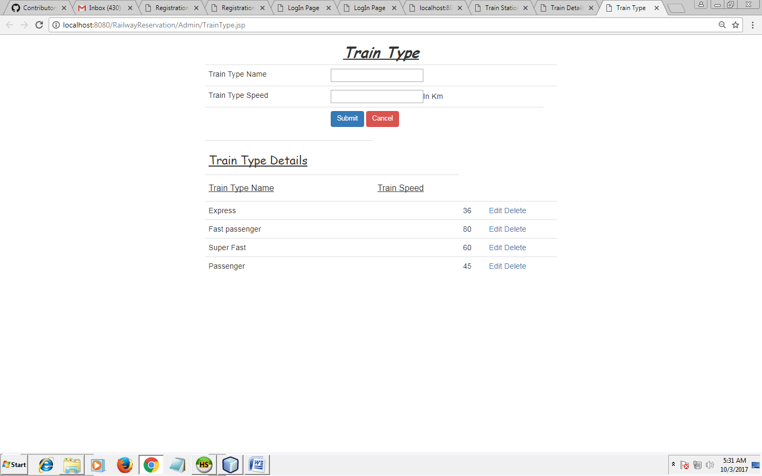
FORMS
Train Type Form

Slide 21
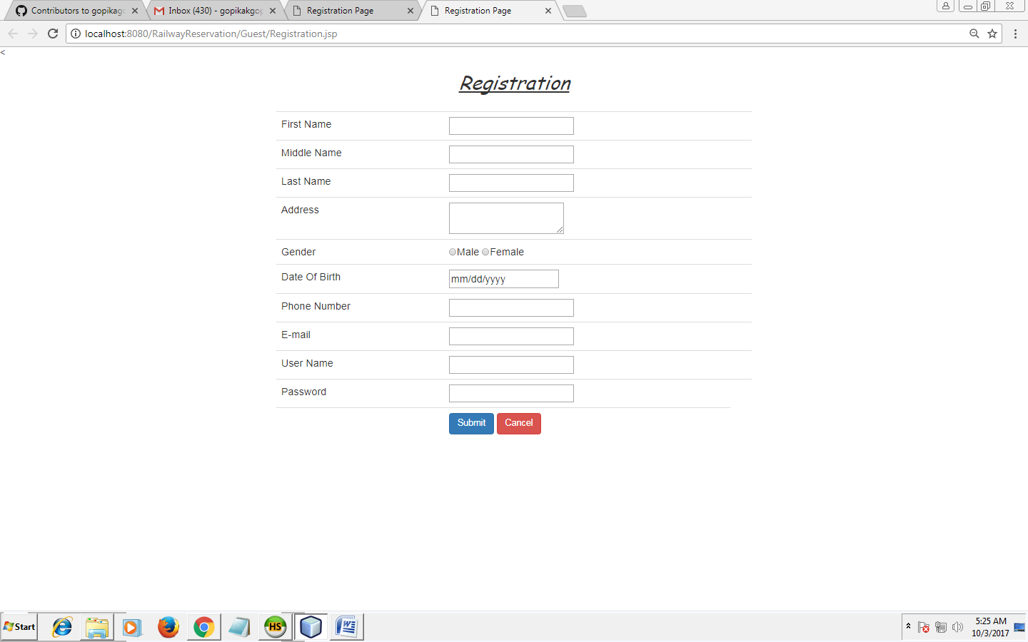
Registration Form

Slide 22
CODING
<%@include file="AdminHeader.jsp" %>
<%@page import="java.sql.ResultSet"%>
<html>
<head>
<script>
function validate()
{
var status="true";
var regtype=/^[A-Za-z ]{3,15}$/;
var typename=document.getElementById('txttype').value;
if((typename.match(regtype)))

Slide 23
{
document.getElementById('valtype').innerHTML="";
}else
{
document.getElementById('valtype').innerHTML="Enter Train Type";
status="false";
}
var regspeed=/^[0-9 ]{1,3}$/;
var typespeed=document.getElementById('txtspeed').value;
if((typespeed.match(regspeed)))
{
document.getElementById('valspeed').innerHTML="";
}else
{
document.getElementById('valspeed').innerHTML="Enter Train Speed";
status="false";
}

Slide 24
if(status=="true")
{
return true;
}else
{
return false;
}
}
</script>
<meta http-equiv="Content-Type" content="text/html; charset=UTF-8">
<title>Train Type</title>
</head>
<center><h2 style="font-family: cursive"><i><u><b>Train Type</b></u></i></h2></center>

Slide 25
<%
String submit=request.getParameter("save");
if(submit!=null)
{
String traintype_name=request.getParameter("txttraintypename");
String traintype_speed=request.getParameter("txttraintypespeed");
if(request.getParameter("hid")!="")
{
String up="update tbl_traintype set traintype_name='"+traintype_name+"',traintype_speed='"+traintype_speed+"' where traintype_id='"+request.getParameter("hid")+"'";
boolean b=obj.insert(up);
if(b)
{
response.sendRedirect("TrainType.jsp");
}out.println(up);
}else
{

Slide 26
String ins="insert into tbl_traintype(traintype_name,traintype_speed)values('"+traintype_name+"','"+traintype_speed+"')";
boolean b=obj.insert(ins);
if(b) {
response.sendRedirect("TrainType.jsp");
} out.println(b);
} }
%>
<%
if(request.getParameter("did")!=null)
{
String del="delete from tbl_traintype where traintype_id='"+request.getParameter("did")+"'";
boolean b= obj.insert(del);
if(b)
{
response.sendRedirect("TrainType.jsp");
}
}
%>
<form name="f1">

Slide 27
<center>
<table class="table table-hover">
<input type="hidden" name="hid" value="<%=Editid%>" >
<tr><td>Train Type Name</td><td><input type="text" id="txttype" required="" value="<%=traintypename%>" name="txttraintypename"><td><div style="color: red" id="valtype"></div></td></td></tr>
<tr><td>Train Type Speed</td><td><input type="text" id="txtspeed" required="" value="<%=traintypespeed%>" name="txttraintypespeed">In Km<td><div style="color: red" id="valspeed"></div></td></td></tr>
<tr><td></td><td><input type="submit" class="btn btn-primary" name="save" onclick="return validate()" value="Submit">
<input type="reset" class="btn btn-danger" name="Cancel" value="Cancel"></td></tr>
</table>
<table class="table table-hover">
<tr><td><h3 style="font-family: cursive"><u>Train Type Details</u></h3></td></tr>
<tr><td><h4><u>Train Type Name</u></h4></td>
<td><h4><u>Train Speed</u></4></td></tr>
<%
String sel="select * from tbl_traintype";
ResultSet rs=obj.select(sel);
while(rs.next())
{%>

Slide 28
<tr><td><%=rs.getString("traintype_name")%></td><td>
<td><%=rs.getString("traintype_speed")%></td><td>
<a href="TrainType.jsp?eid=<%=rs.getString("traintype_id")%>">Edit</a>
<a href="TrainType.jsp?did=<%=rs.getString("traintype_id")%>">Delete</a></td></tr>
<%}
%>
</table>
</center>
</form>
</body>
</html>

